Slide 1

marketing analysis on Airline Loyalty Program
Joel Addala

Slide 2
Dataset Description
To Note:
Dated from 2012 – 2018
In effort to increase retention, conducted a promotion in 2018.
Two datasets:
Customer History (Demographic)
Customer Activity (Bookings, Distance, Points, etc.)
Over 400,000 Records, and 26 Features.
Source: Free Data Sets & Dataset Samples | Maven Analytics
Notes:
Customer loyalty program data from Northern Lights Air (NLA), a fictitious airline based in Canada. In an effort to improve program enrollment, NLA ran a promotion between Feb - Apr 2018. Dataset includes loyalty program signups, enrollment and cancellation details, and additional customer information.

Slide 3
Problem Statement
Questions:
Was the 2018 Promotion effective?
What affects Customer Churn?
How can we segment the Customers?

Slide 4
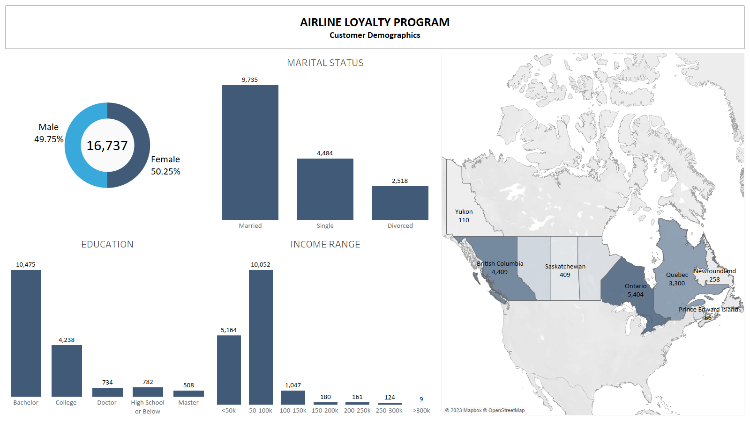

Slide 5
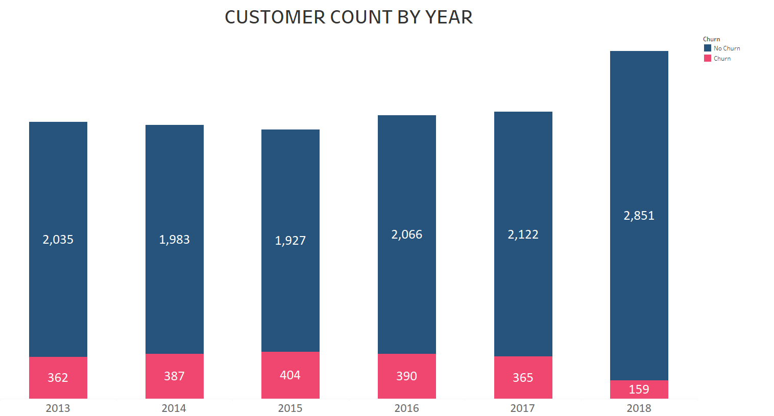
Q1 - customer base
Customer base is constant since 2013-2017 with noticeable increase in 2018

Slide 6
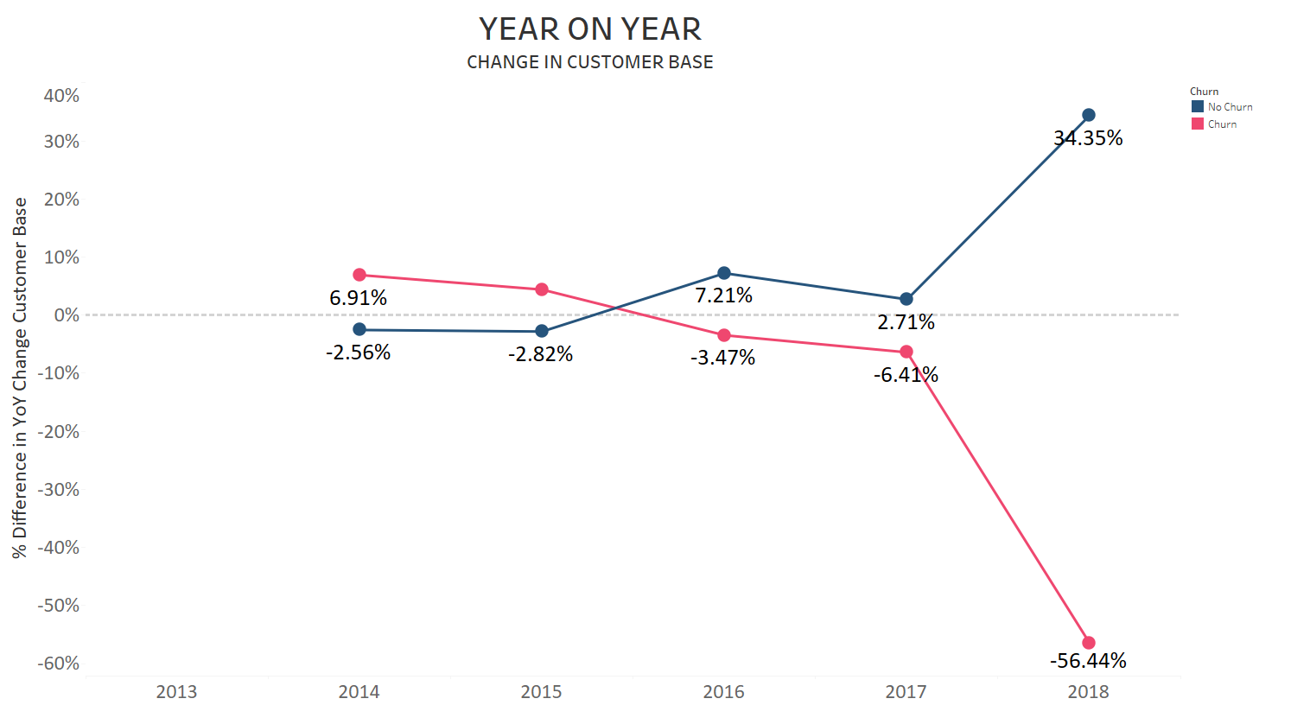
Q1 - year on year customer base
From 2017 – 2018 Customer base has increase by 35% and Churn has been reduced by 50%

Slide 7
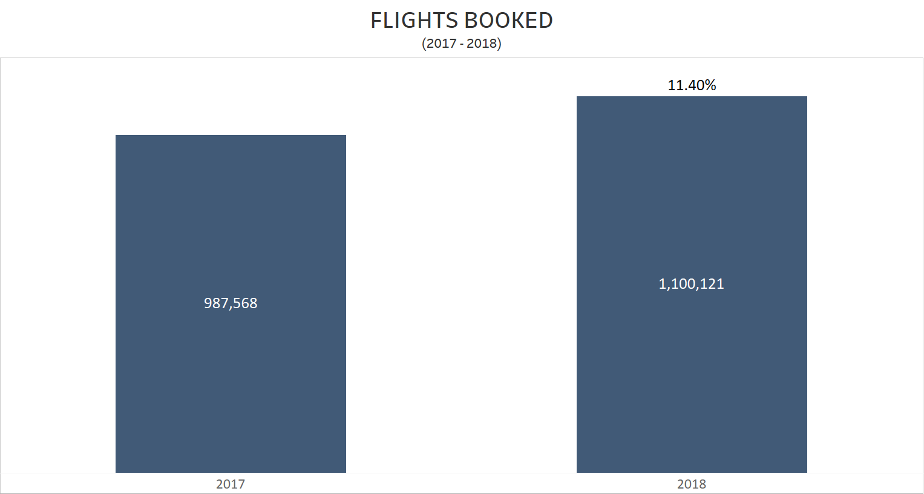
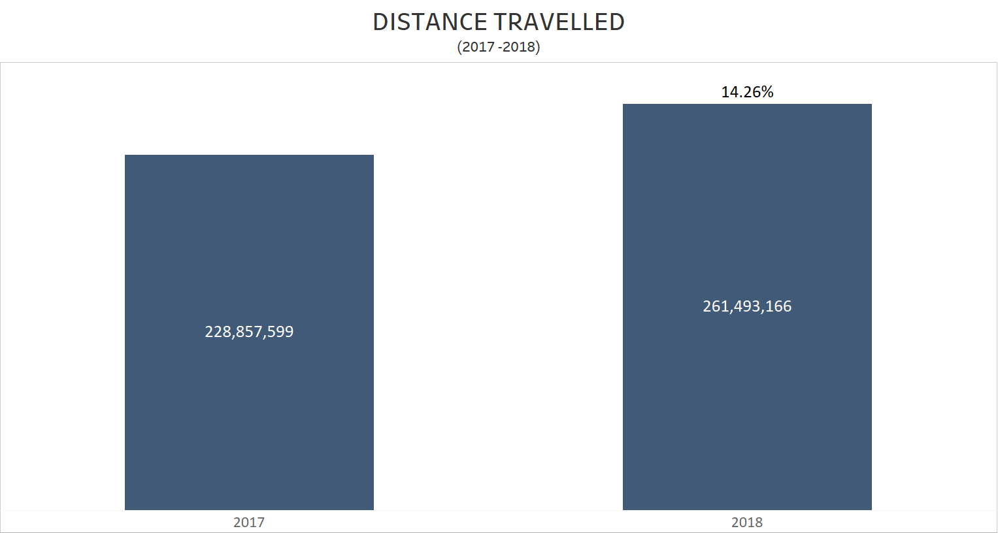
Q1 - FLIGHTS booked& Travel Distance
Increase in customer activity by 11%
Increase in Travel Distance by 14%

Slide 8
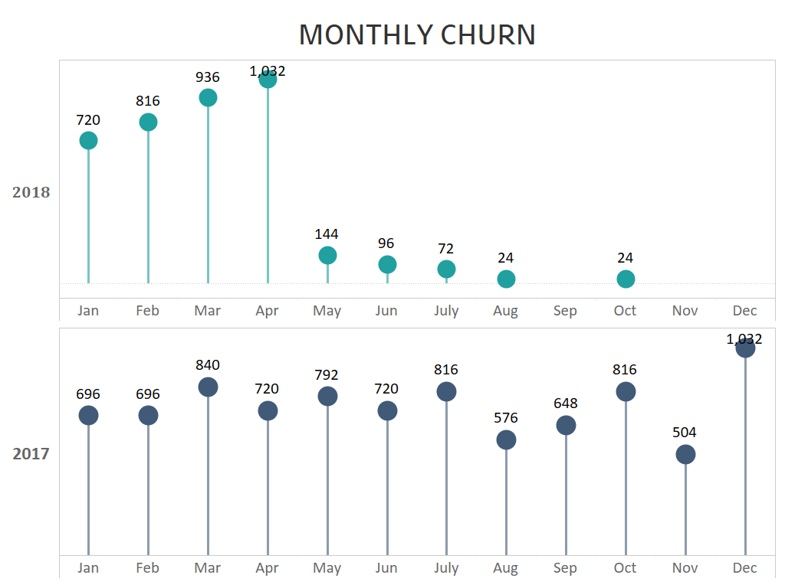
Q2 – monthly Churn rate
2018 has significantly lesser churn than 2017
Most of which is associated to January through April

Slide 9
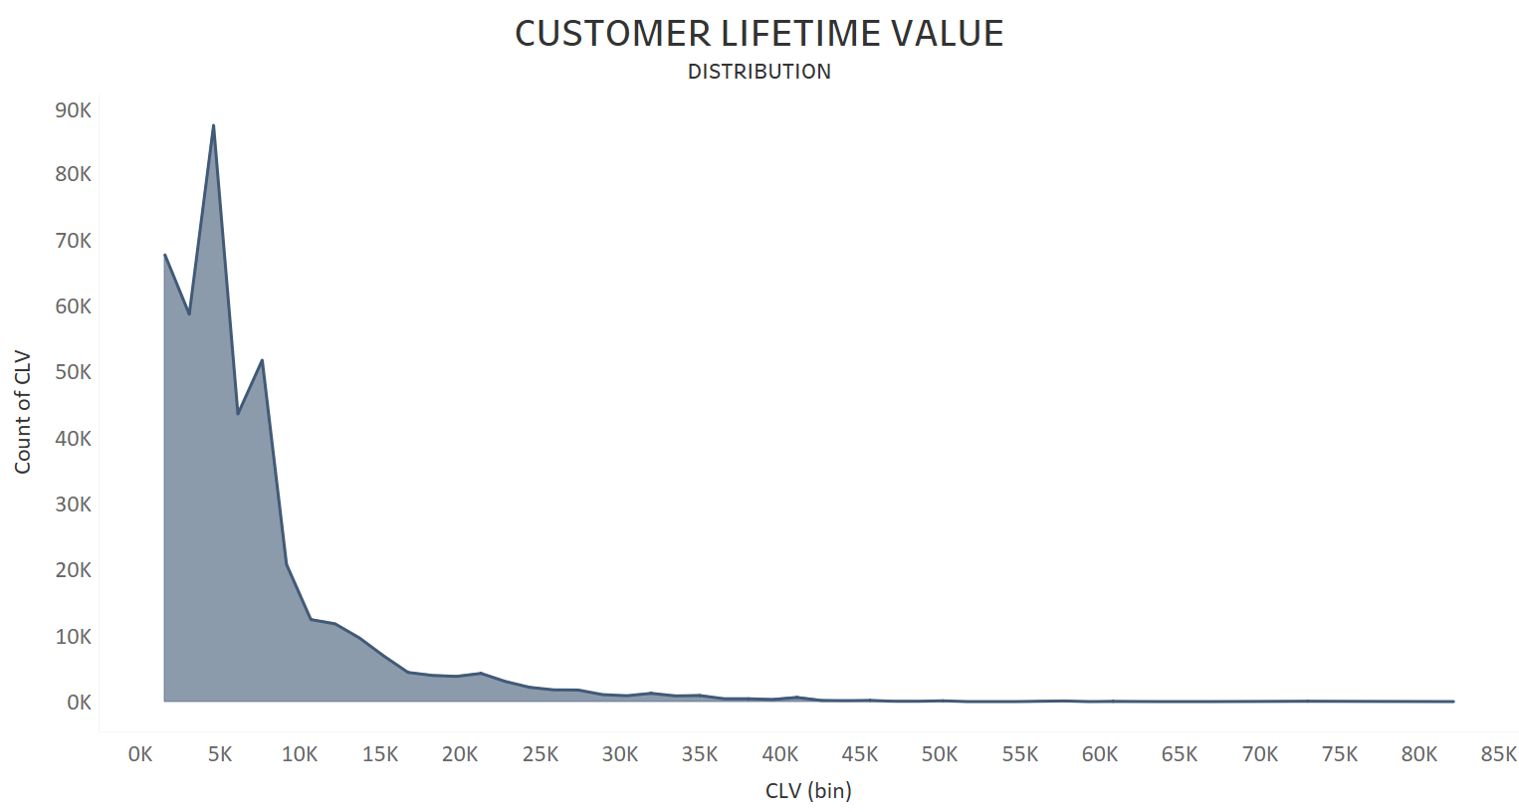
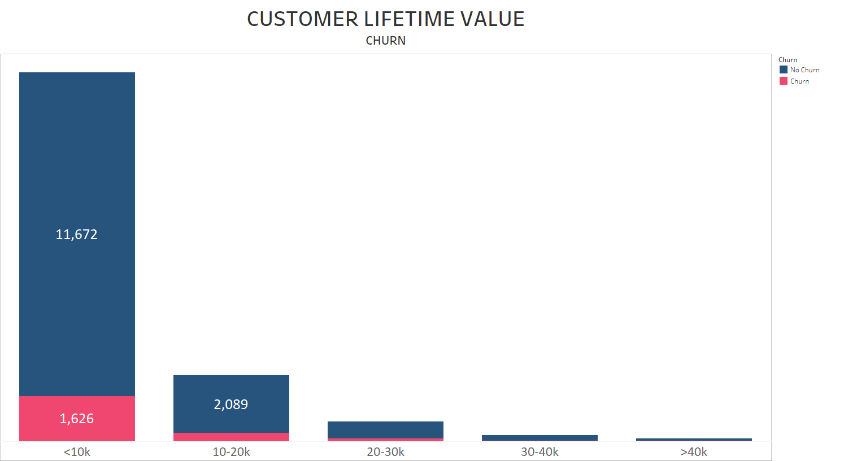
Q2 - Customer lifetime value
Major distribution is under 10k
Customers whose Lifetime value is under 10k, likely churn

Slide 10
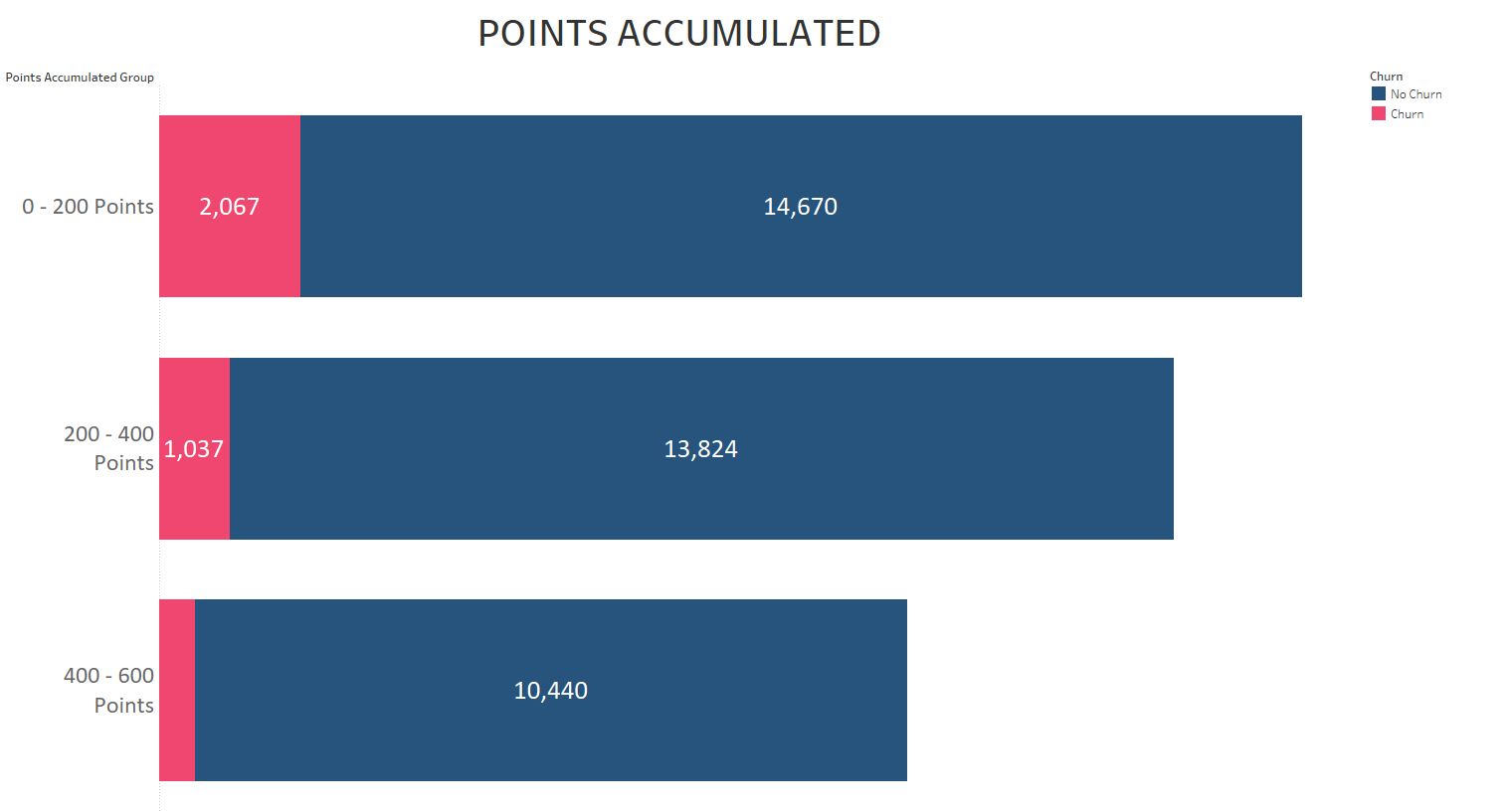
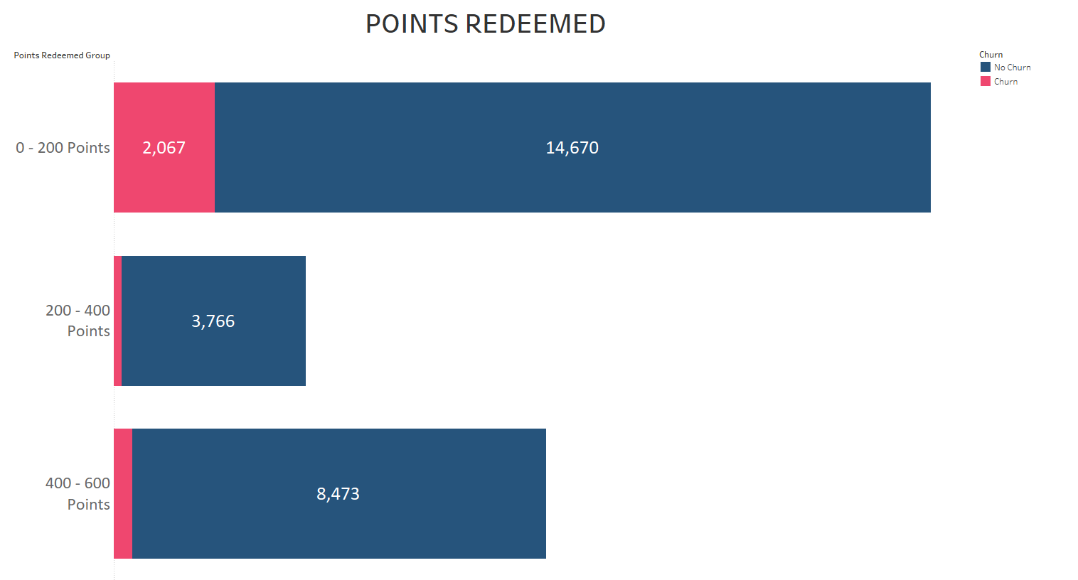
Q2 - accumulating & Redeeming Points
Anomaly across customers with 200-400 Points
They do not redeem as much as the other groups

Slide 11
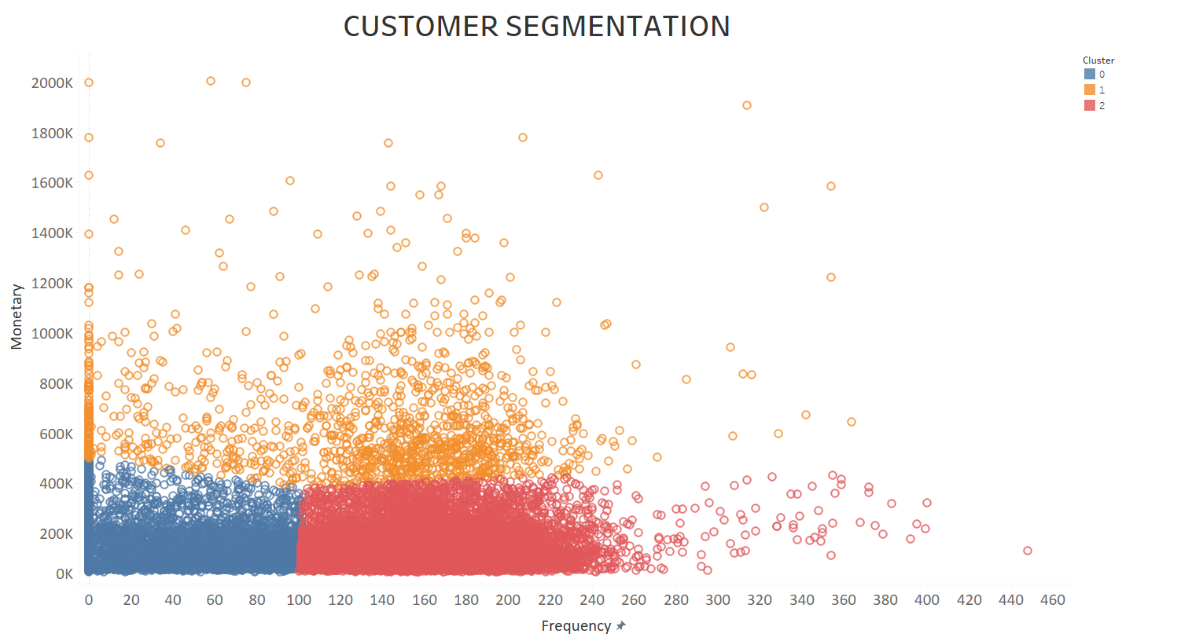
Segmentation
Used K-Means Algorithm and Elbow method to identify the optimal segments
Identify the segments as Low frequent-Low Value, High frequent-Low Value, and High Value Customers.

Slide 12
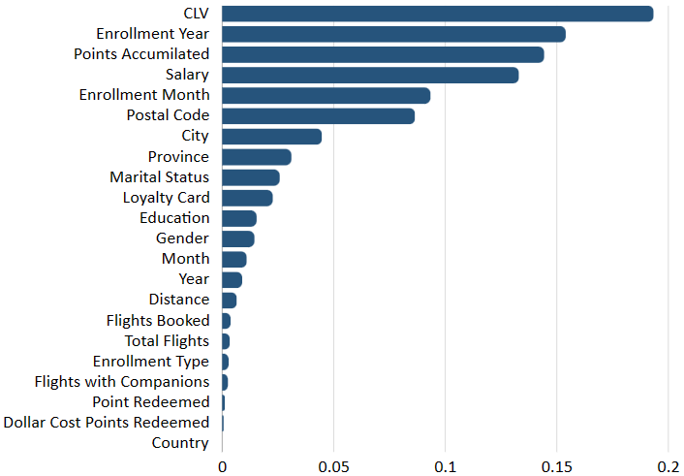
Modelling
Data Transformations:
Encoding – Manual, Category Encoders
Data Balancing – Random Oversampling
Feature Engineering – Churn, RFM
Modelling Process:
Hyperparameter Tuning: GridSearchCV
Feature Importance: Greater than 0.01

Slide 13
Modelling
Models:
Logistic Regression, Adaboost Classifier, Decision Trees, Random Forest
Best Model: Decision Trees
Best Metric: Recall
It ensures that no customer that will churn is missed out by the model
Model | Decision Tree | Random Forest | Adaboost | Logistic Regression
Recall | 95.30% | 88.02% | 83.57% | 86.12%
Accuracy | 98.73% | 98.49% | 73.52% | 57.14%

Slide 14
Insights & Recommendations
Enhance and Redeploy the 2018 Promotion.
Low-Mid income customers are most likely to churn
They are the Major Demographic
Focusing on them will help increase revenue and reduce churn
Higher Churn rates at the beginning of the year
Offer Seasonal Discounts or Offers
Lots of Points are being accumulated but not used.
Incentivize customers to spend accumulated points
Rethink the strategy behind points.

Slide 15
Thank you

